Slide 1

StudyFlow with AI
Revolutionize your study routine with intelligent planning, focus tools & AI assistance
AI-powered student productivity workspace

Slide 2




Studying Harder Isn't Always Studying Smarter
Overwhelming assignments
Distractions & procrastination
Forgetting what you studied
Burnout from poor planning
Too many deadlines, scattered notes and no single place to track priorities.
Without a review system, knowledge fades and last-minute cramming takes over.
Inconsistent routines and no progress visibility lead to stress and exhaustion.
Ends up scrolling instead of studying — focus slips away quickly.

Slide 3

Your All-in-One AI Study Flow
From chaos to focused flow — powered by AI. Integrated dashboard for tasks, notes, flashcards and focus sessions in one elegant workspace.

Slide 4

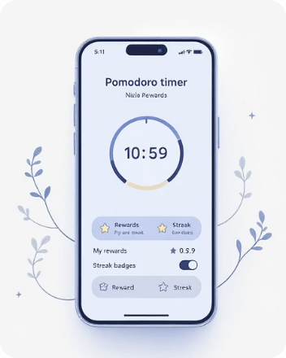


Core Features — Smart Workflow Essentials
Smart Task & Homework Management
Pomodoro Focus Timer
AI-Powered Note Taking & Auto-Flashcards
Science-Based Spaced Repetition
Science-backed focus blocks with rewards, streak tracking and gentle reminders to rest.
Optimised review schedules that increase retention while reducing total study time.
Import Google Classroom, set deadlines, auto-prioritise tasks and get suggested study windows.
Auto-extract highlights, generate concise notes and create ready-to-review flashcards in one click.

Slide 5


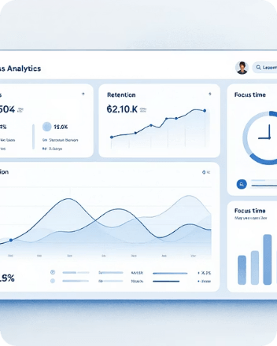

Core Features — Motivation & Insights
Gamified Rewards & Virtual Study Rooms
AI Summaries & Explanations
Progress Analytics & Motivation Dashboard
Clean, Distraction-Free Interface
Earn points, join rooms with peers, and turn study sessions into motivating rituals.
Instant, context-aware summaries and step-by-step explanations for tough concepts.
Minimal, accessible layouts tuned for deep work and mobile-friendly reviews.
Track focus, retention and streaks with clear visuals that keep motivation high.

Slide 6


How It Works — 4-Step Flow
Import Tasks
Focus Sessions
Add tasks and notes quickly
Use Pomodoro and earn rewards
AI Creates Flow
Review & Retain
Generates cards, flows, schedule
Spaced repetition boosts memory
Import tasks, let AI design an optimised study flow, focus with structured sessions, then review using spaced repetition — repeat for continuous improvement.

Slide 7



Why Students Love It
"Finally an app that understands student life!"
— Alex, Med Student
"My grades improved without extra hours — just smarter reviews."
— Priya, Undergraduate
"The Pomodoro rewards actually keep me coming back."
— Marcus, High-school Senior
"Auto-flashcards saved my exam prep."
— Sara, Graduate Student

Slide 8

Lovable.dev
Rapid Prototyping, Real Results
StudyFlow was prototyped and powered by Lovable — an AI app builder that turns ideas into functioning apps fast. Smart backend AI pipelines generate note summarisation, flashcard creation and adaptive scheduling.
Seamless integration with classroom platforms makes deployment simple for educators and students alike.

Slide 9

Results & Benefits
2× Better Focus
40% Higher Retention
Structured sessions and timers double productive study time versus unfocused attempts.
Spaced repetition and AI-curated flashcards improve long-term memory.
Less Time, Better Grades
Optimised schedules reduce wasted hours while increasing outcomes.

Slide 10

Start Your Free Flow Today
https://studyflowwithai.lovable.app/
1
Free
Essential features: task sync, basic Pomodoro, limited flashcards, community rooms.
2
Premium
Full AI summaries, unlimited flashcards, advanced analytics, priority support.
Try StudyFlow with AI Now →

